Slide 1

Web of Things (WoT) IG/WG
Michael McCool
September 21, 2020

Slide 2
Goal and Use Cases
IoT Interoperability
Simplify usage
Interaction abstraction
Simplify data ingestion
Unified data schemas
Bridge silos
Protocol bindings
Enable "mashups"
Scripting API

Slide 3
Current Work Items
Deliverables | Updates | New
Informative | Scripting API Security and Privacy Guidelines Best Practices | Use Cases
Normative | Architecture Thing Description | Discovery Profiles

Slide 4

Thing Description
{
"@context": [
"https://www.w3.org/2019/wot/td/v1",
{ "iot": "http://iotschema.org/" }
],
"id": "urn:dev:org:32473:1234567890",
"title": "MyLEDThing",
"description": "RGB LED torchiere",
"@type": ["Thing", "iot:Light"],
"securityDefinitions": ["default": {
"scheme": "bearer"
}],
"security": ["default"],
"properties": {
"brightness": {
"@type": ["iot:Brightness"],
"type": "integer",
"minimum": 0,
"maximum": 100,
"forms": [ ... ]
}
},
"actions": {
"fadeIn": {
...
Metadata for IoT services
ID, versions, types, creation time, ...
Titles, descriptions, ...
Describes interactions
What they are (abstraction)
How to use them (protocol binding)
How to interpret data (schemas)
JSON-LD 1.1
Vocabulary extensions
Semantic annotation (e.g. OneDM)
Protocol-specific vocabulary

Slide 5
New Work Items
Use Cases:
Expanding catalog of use cases
Identifying requirements
Identifying gaps and overlaps
Edge computing
Geospatial systems
Data modeling
...
Discovery:
Define how TDs are distributed
Allow for ad-hoc use cases
Both local and global contexts
Spatial search not limited to local network
Two-phase introduction/exploration
Introductions use existing mechanisms
Explorations include directory service and peer-to-peer metadata retrieval
Emphasis on privacy protection
Introductions identify exploration services
Exploration services provide metadata only after authentication/authorization
Protect not only metadata but queries
Mitigate fingerprinting risks
Interoperability Profiles:
Support interoperability
Out-of-the-box plug-and-play
Constrain features
Allow for finite, in-advance implementation of consumers

Slide 6
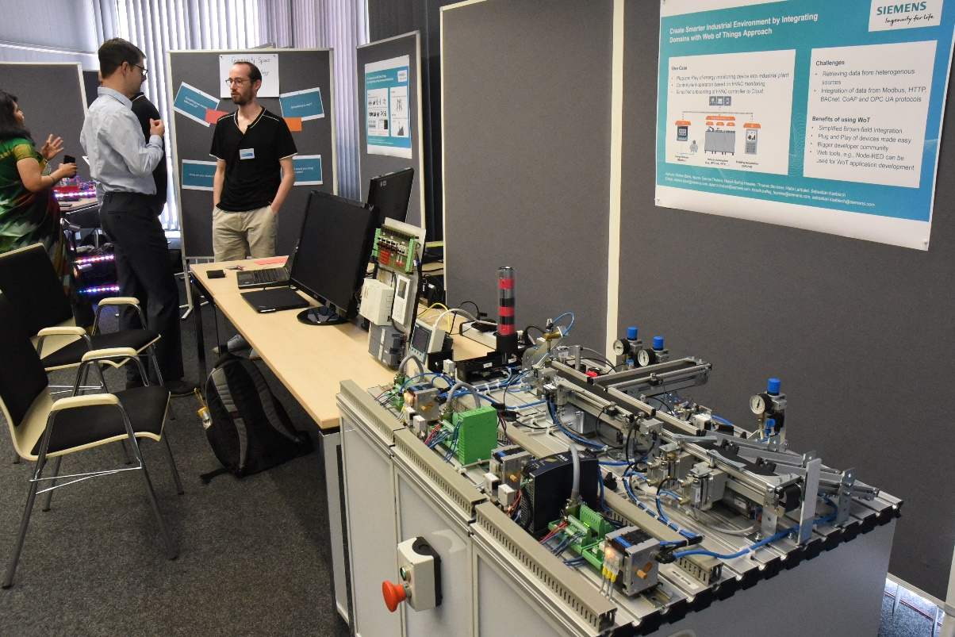
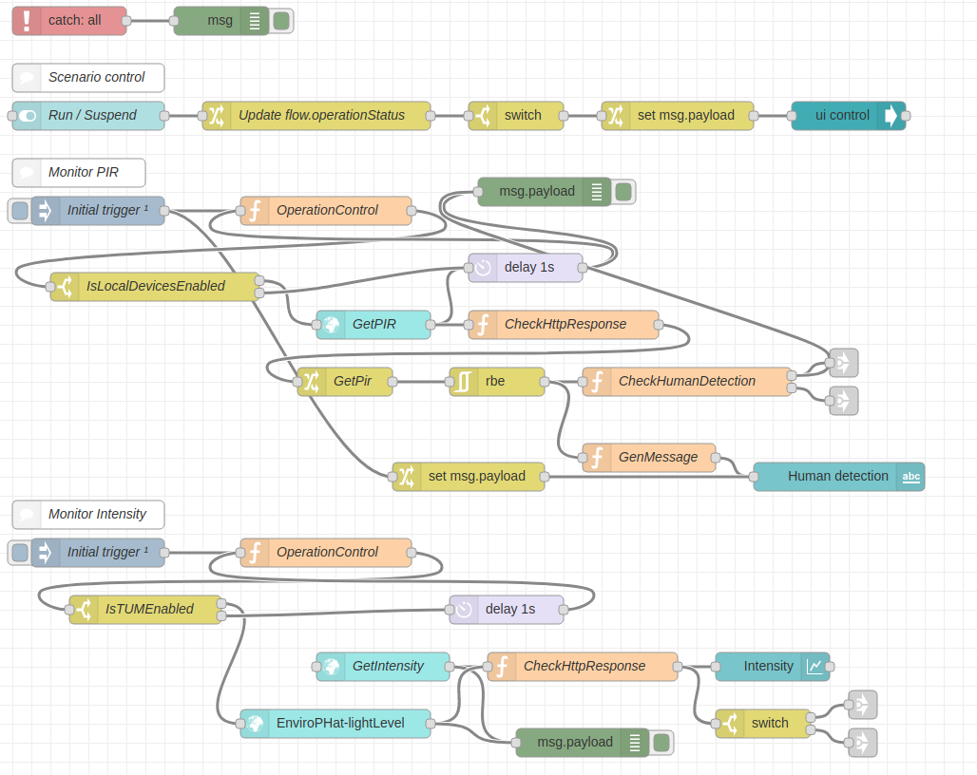
Other Activities
Implementations
Testing and Validation
Node-wot
Scripting API implementation
Node-gen
Node-RED integration
Playground
TD checker
Plugfests

Slide 7
W3C WoT Resources
W3C WoT Wiki
https://www.w3.org/WoT/IG/wiki (IG/WG organizational information)
W3C WoT Interest Group
https://www.w3.org/2016/07/wot-ig-charter.html (old charter)
https://www.w3.org/2019/10/wot-ig-2019.html (new charter)
https://lists.w3.org/Archives/Public/public-wot-ig/ (mailing list)
https://github.com/w3c/wot (technical proposals)
W3C WoT Working Group
https://www.w3.org/2016/12/wot-wg-2016.html (old charter)
https://www.w3.org/2020/01/wot-wg-charter.html (new charter)
https://www.w3.org/WoT/WG/ (dashboard)
W3C WoT Candidate Recommendations
https://www.w3.org/TR/wot-architecture/
https://www.w3.org/TR/wot-thing-description/
W3C WoT Working Drafts / Group Notes
https://www.w3.org/TR/wot-binding-templates/
https://www.w3.org/TR/wot-scripting-api/
https://www.w3.org/TR/wot-security/
W3C WoT Editors’ Drafts and Issue Tracker
https://github.com/w3c/wot-architecture/
https://github.com/w3c/wot-thing-description/
https://github.com/w3c/wot-binding-templates/
https://github.com/w3c/wot-scripting-api/
https://github.com/w3c/wot-security/
https://github.com/w3c/wot-security-best-practices/
https://github.com/w3c/wot-profile/
https://github.com/w3c/wot-discovery/
Reference Implementations and Tools: node-wot
node-wot: https://github.com/eclipse/thingweb.node-wot
TD playground: https://github.com/thingweb/thingweb-playground

Slide 8
Contacts
https://www.w3.org/WoT/WG/
Dr. Michael McCool
Principal Engineer
Intel
Technology Pathfinding
michael.mccool@intel.com
Dr. Sebastian Kaebisch
Research Scientist
Siemens
Corporate Technology
sebastian.kaebisch@siemens.com

